Slide 1
CHameleon: Adaptable infrastructure for reproducible science
Kate Keahey
Mathematics and CS Division, Argonne National Laboratory
CS Department, University of Chicago
keahey@uchicago.edu
5th Chameleon User Meeting , November 2024

Slide 2
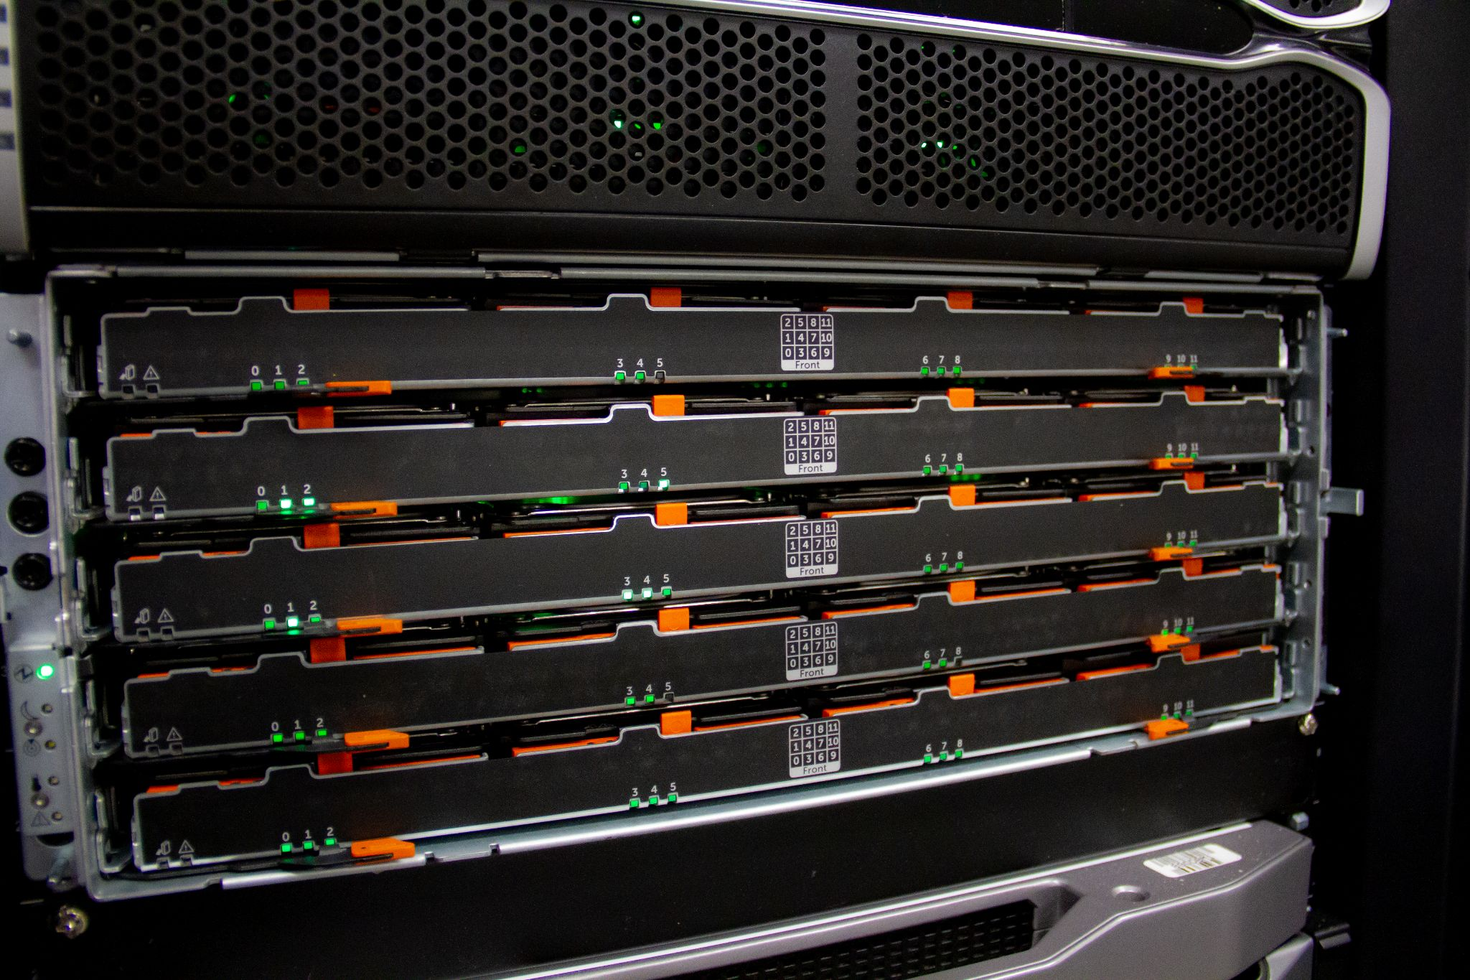
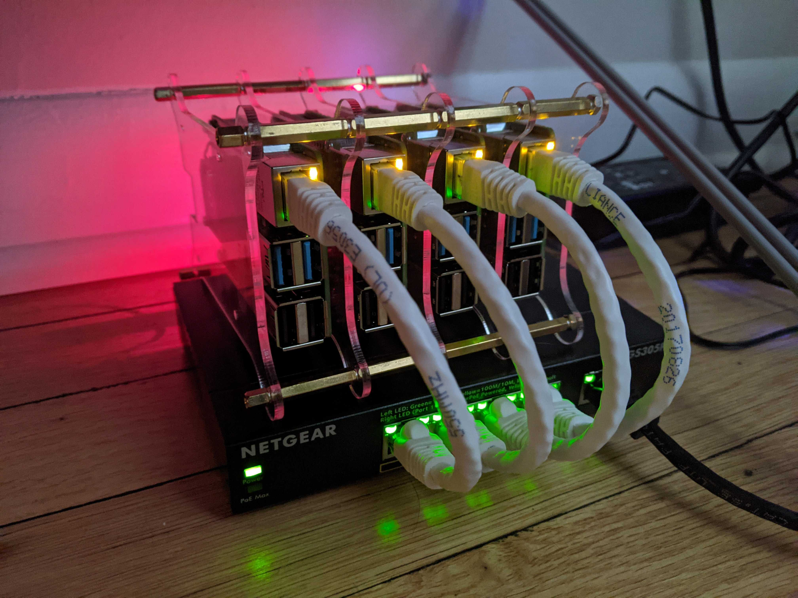
1,000+
Unique projects
700+ Papers published
11,000+
Users
Notes:
the number of active research projects is increasing year on year by 13% on average;
the number of active education projects almost doubled in the last three years;
and the average number of new users rose from 86 per month in 2020 to 199 this year.

Slide 3
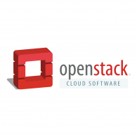
Chameleon: AN Edge To cloud testbed
Chameleons like to change – testbed that adapts to your experimental needs
From bare metal reconfigurability/isolation -- KVM cloud – to containers for edge (CHI@Edge)
Capabilities: power on/off, reboot, custom kernel boot, serial console access, etc.
From large to small – diversity and scale in hardware:
Supercomputing datacenters (UC/ALCF, TACC, NCAR) over 100G network – to edge devices
Diverse: FPGAs, GPUs, NVMe, NVDIMMs, Corsa switches, edge devices via CHI@Edge, etc.
Distributed: CHI-in-a-Box sites at Northwestern and UIC – and now also NRP!
Based on mainstream open source – proud to be cheap!
50% leveraging and influencing OpenStack + 50% “special sauce” (incl. fed id)
Promoting digital artifact sharing
Programmatic interfaces for non-transactional experiment packaging
Trovi for experiment sharing and discovery, Chameleon Daypass for access sharing

Slide 4
Experiment structure
Create experimental environment
Run
experiment body
discover
resources
allocate
resources
configure environment
- Fine-grained
- Complete
- Up-to-date
- Versioned
- Verifiable
- Allocatable resources: nodes, VLANs, IPs
- Advance reservations and on-demand
- Non-fungible
- Isolation
- Bare metal, KVM, containers
- Image catalog
- Snapshotting
- Network stitching
- Orchestration
analyze and present results
Authentication via federated identity, accessed via GUI, CLI, and python-chi
Paper: “Lessons Learned from the Chameleon Testbed”, USENIX ATC 2020
Notes:
Highlight:
Interfaces – everything goes via OpenStack-based API (even if it is just a veneer as for CHI@Edge)
Emphasis on *programmatic interfaces* with python-chi and Jupyter – they can be easily scripted/repeated (unlike GUI), preferred by most users

Slide 5
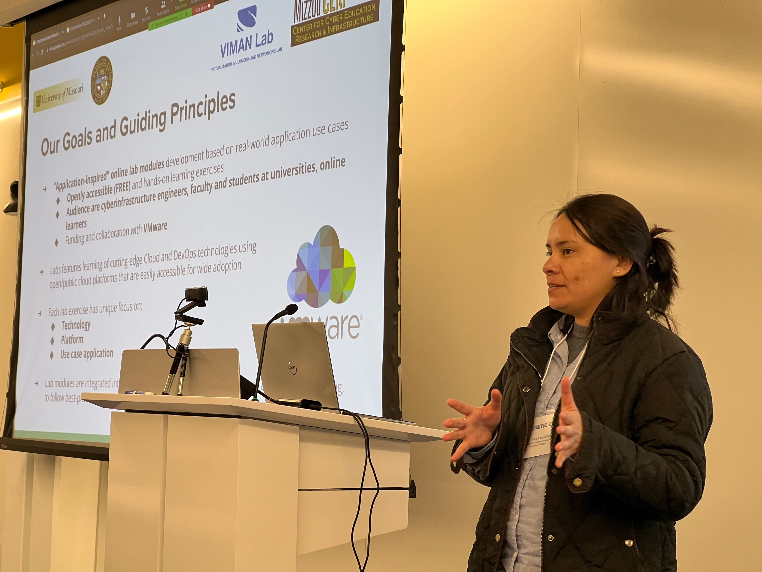
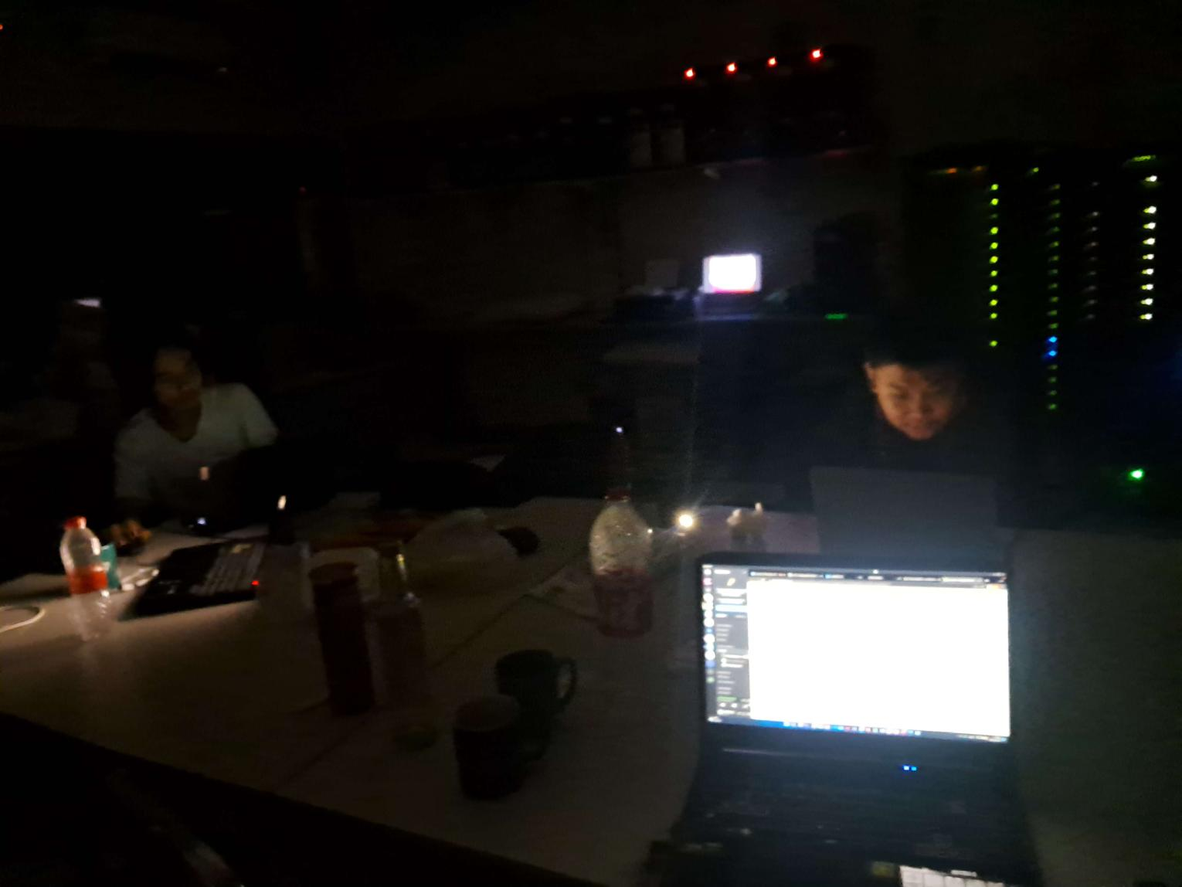
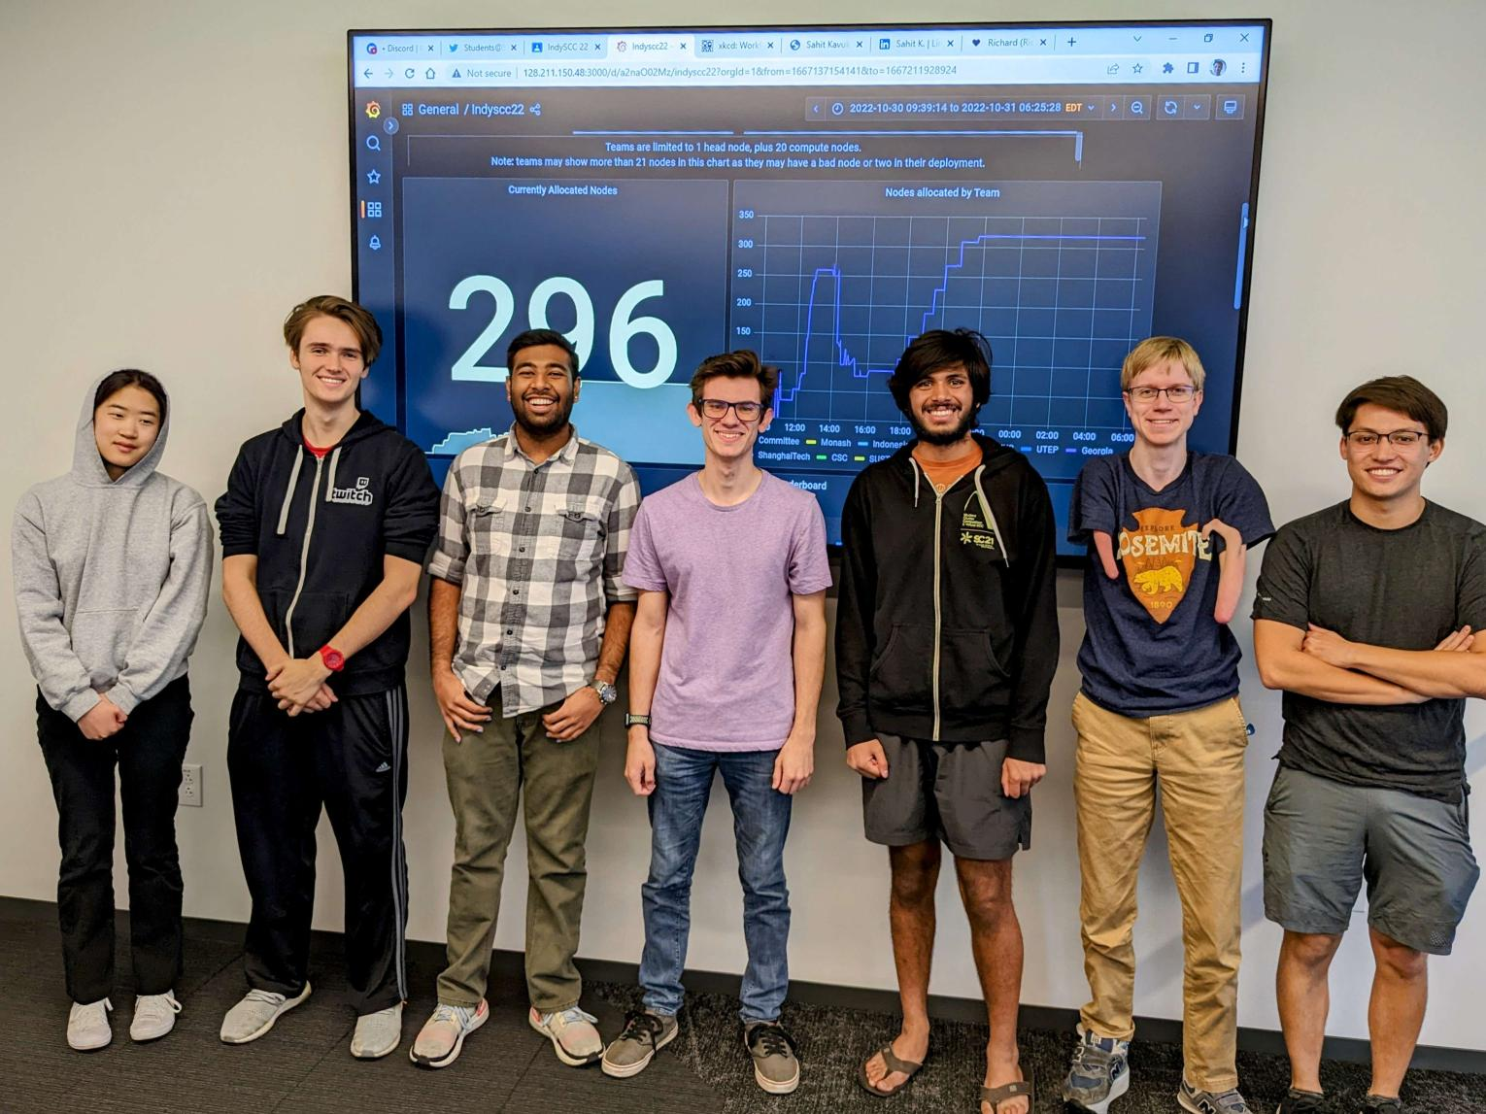
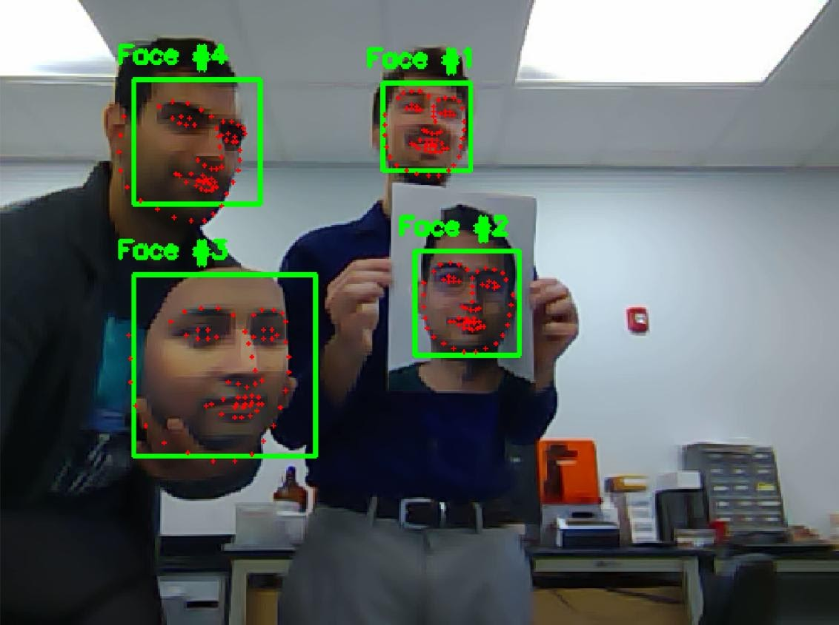
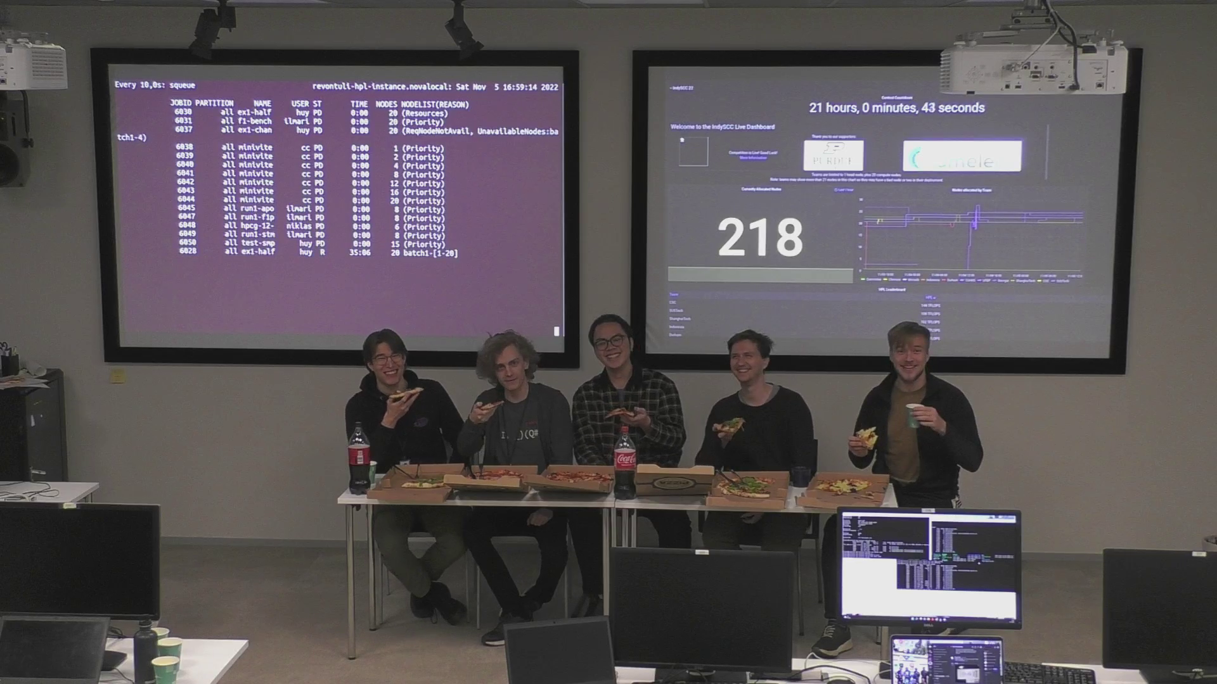
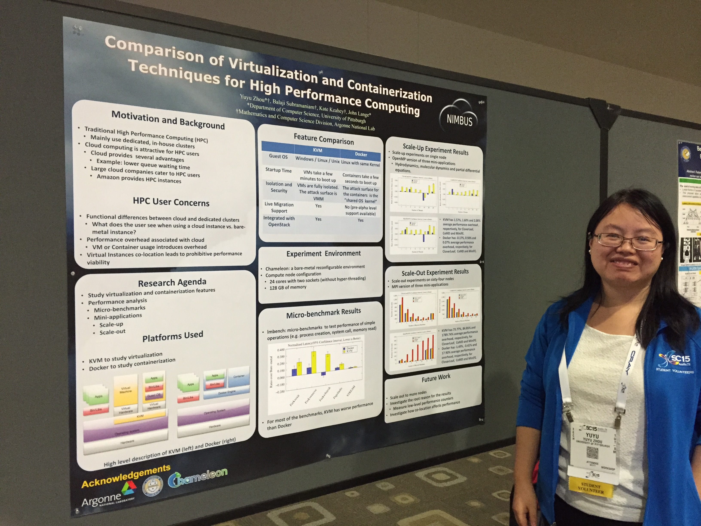
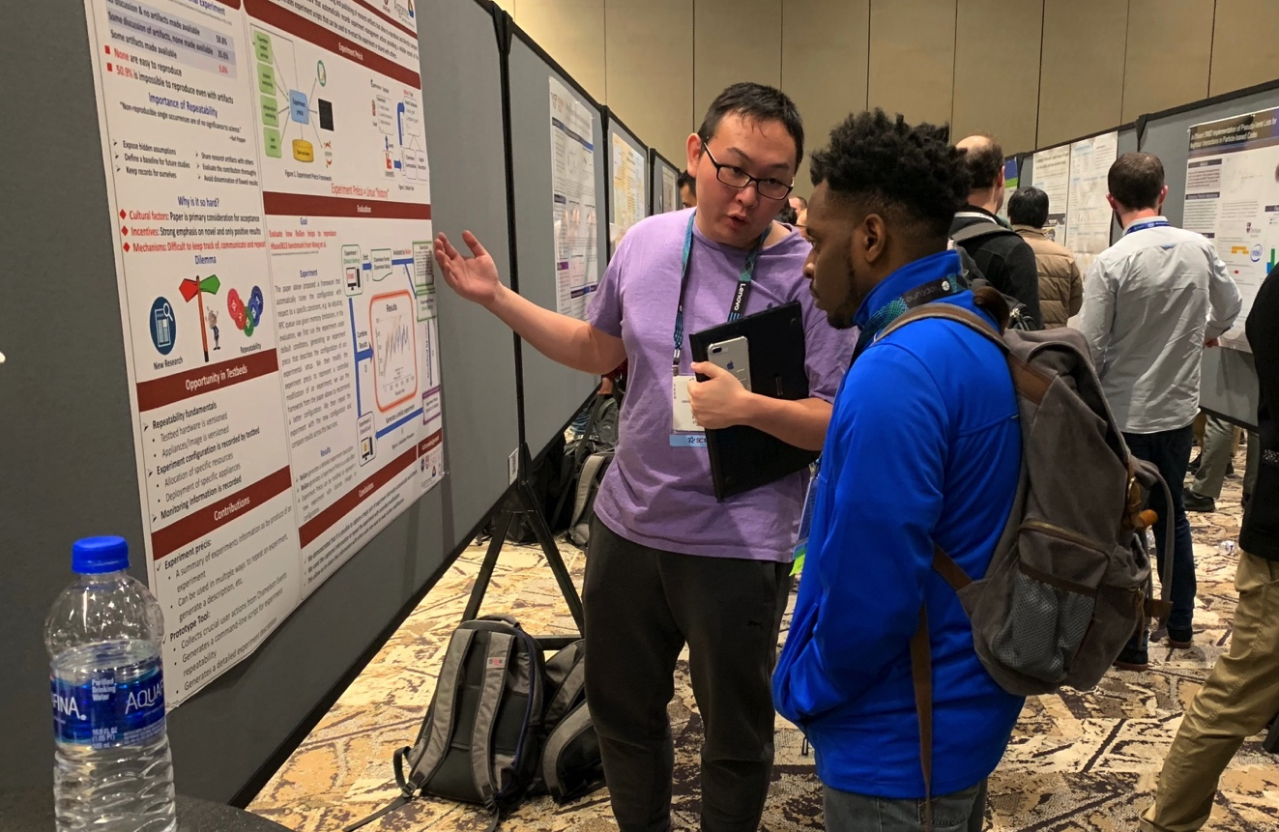
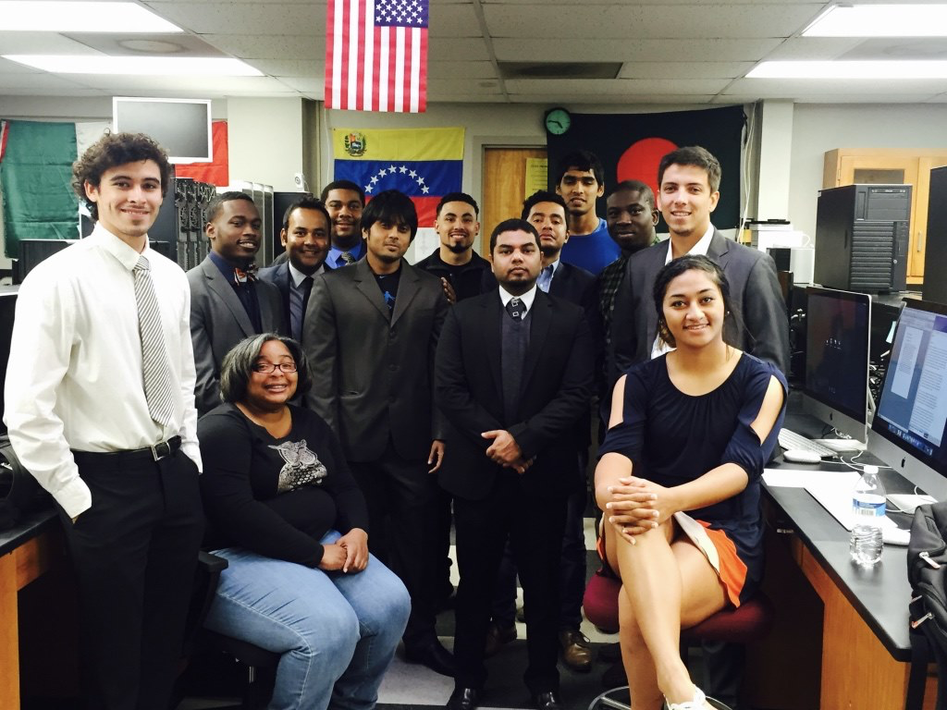
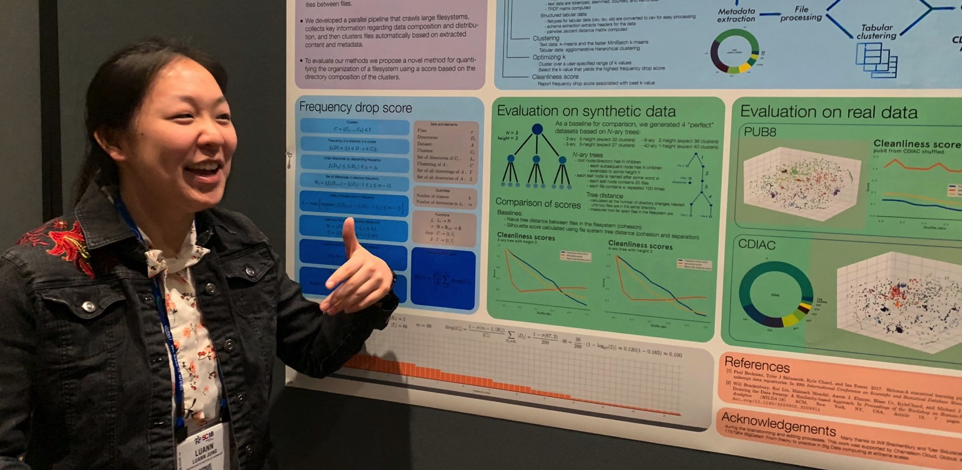
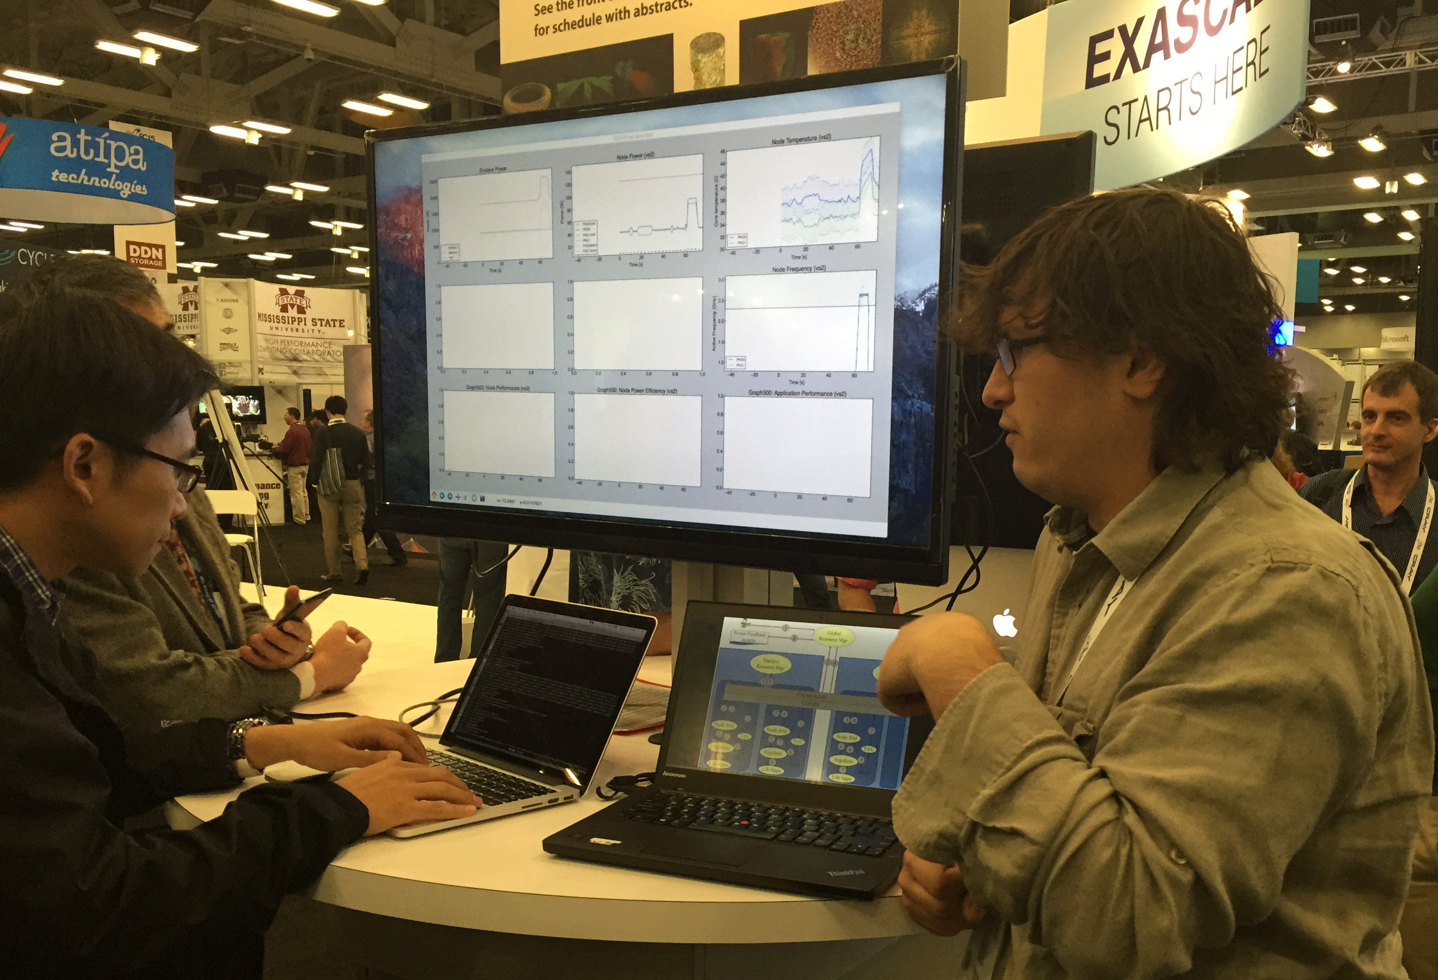
Not just a testbed, a community
Supporting research projects in architecture, operating systems design, virtualization, power management, real-time analysis, security, storage systems, databases, networking, machine learning, neural networks, data science, and many others.
Check out user experiment stories on our blog:
https://www.chameleoncloud.org/blog/category/user-experiments/
Notes:
Anybody wants to find out more it is under the user experiments tab on our blog

Slide 6
10 years of Chameleon: what changed?
Sites and hardware
Shifting emphasis from scale to diversity, adapting investment with the science interest, lesser density to adapt node configurations
General trends: more cores/memory, hardware types, disaggregated hardware, edge
Configuration
Refinements: move to federated identity, support for network stitching, FABRIC layer 3 connection, and others
Orchestration: of scripts, orchestration templates, and notebooks (Jupyter)
Configuration continuum: bare metal, VMs, and containers – adjusting the mix
Packaging configuration: CHI-in-a-Box
Applications/research
Leading research categories: distributed computing, AI/ML, scientific computing/HPC
Fastest growing applications: AI/ML, edge, and reproducibility

Slide 7
Chameleon Hardware (Phase 1)
Switch
Standard Cloud Unit
42 compute
4 storage
x2
To UTSA, GENI, Future Partners
Core Services
Front End and Data Mover Nodes
504 x86 Compute Servers
48 Dist. Storage Servers
102 Heterogeneous Servers
16 Mgt and Storage Nodes
Chameleon Core Network
100Gbps uplink public network
(each site)
Chicago
SCUs connect to core and fully connected to each other
Austin
Switch
Standard Cloud Unit
42 compute
4 storage
x10
Heterogeneous Cloud Units
Alternate Processors and Networks
Core Services
3.6 PB Central File Systems, Front End and Data Movers
Notes:
SCUs: Intel Haswell, OpenFlow compliant Force 10 switches
HCUs: ARM-based microservers, 48 Intel Atom-based microservers, and 24 nodes containing a variety of accelerators, including nVidia GPUs, Convey Field Programmable Gate Arrays (FPGA) accelerator cards, and Intel Xeon Phi.

Slide 8
Chameleon hardware (Phase 2)
Core Services
0.5 PB Storage System
Chameleon Associate Site
Northwestern
Haswell
Standard Cloud Unit
42 compute
4 storage
x2
SkyLake
Standard Cloud Unit
32 compute
Corsa Switch
x2
GENI
and other partners
Chameleon Core Network
100Gbps uplink public network
(each site)
Chicago
Austin
Haswell
Standard Cloud Unit
42 compute
4 storage
x10
SkyLake
Standard Cloud Unit
32 compute
Corsa Switch
x1
Core Services
3.5PB Storage System
Heterogeneous Cloud Units
GPUs (K80, M40, P100),
FPGAs, NVMe, SSDs, IB,
ARM, Atom, low-power Xeon

Slide 9
Chameleon hardware (Phase 3)
CHI@UC
Skylake, CascadeLake, IceLake, AMD nodes, and GigaIO GPUs (A100, V100, RTX6000), FPGAs (Xilinx Alveo U280)
Storage (NVMe SSD, NVDIMM)
Network (Corsa SDN, 25G Ethernet, 200G InfiniBand)
Chameleon Volunteer Sites
Storage
~0.5 PB
CHI@Edge
Raspberry Pi, Jetson Nano, Jetson Xavier NX, AGX Orin
+ User-added devices
Network
100Gbps public network
Chicago
Austin
CHI@TACC
Haswell, SkyLake, CascadeLake, Fugaku (ARM64 + HBM), AMD nodes, and LIQID/GigaIO disaggregated hardware
GPU (K80, M40, P100, MI100), FPGAs (Altera)
Storage (NVMe, SSD, NVDIMM)
Network (Corsa SDN, 25G Ethernet, 200G InfiniBand)
Commercial Clouds via CloudBank
Storage
~3.5PB
FABRIC, FAB
and other partners
Notes:
UC
42x Intel nodes with 48 cores and 192GB of RAM, 10x AMD Epyc with 48 cores, 256GB of RAM, and a 960GB NVMe root disk. Additionally, a subset:
2 nodes, each with 2x Intel D7-P5510 7.68TB datacenter SSDs
2 nodes, each with 2x Samsung PM1733 7.68TB datacenter SSDs
2 nodes, each with 4x Samsung PM1733 1.92TB datacenter SSDs
2 nodes, each with 2x Corsair Force MP600 2TB consumer SSDs
2x: Intel Optane nodes with 112 Cores, 768GB of RAM, and 3TB of NVDIMMs
3x: Intel nodes with 4x Nvidia V100 GPUs connected by NVLink
1x: Intel node with 4x Nvidia V100 GPUs connected by PCIe
16x of the regular compute nodes have HDR100 (100gb/s) InfiniBand, as do all of the Optane and GPU nodes. All the SSD nodes have HDR (200gb/s) InfiniBand.
At TACC
32x compute_zen3: AMD nodes, each with 2x two AMD EPYC 7763 (128c / 256t), 256GB RAM, 480GB ssd storage.
8x gpu_mi100: same specs as compute_zen3, with addition of 2x AMD MI100 GPUs each
All 40 are connected via HDR100 Infiniband.
Volunteer sites:
NCAR: ARM Thunder Nodes
IIT, Northwestern, & UIC: Chameleon Legacy program
Purdue: ~400 of their own Haswells added on an ephemeral basis to support IndySCC specifically

Slide 10
Chameleon hardware
Coming soon: Dell XE9640,
2x Intel 9468 CPU / 4x Nvidia H100
CHI@UC
Skylake, CascadeLake, IceLake, AMD nodes, and GigaIO GPUs (A100, V100, RTX6000), FPGAs (Xilinx Alveo U280)
Storage (NVMe SSD, NVDIMM)
Network (Corsa SDN, 25G Ethernet, 200G InfiniBand)
Commercial Clouds via CloudBank
FABRIC, FAB
and other partners
Storage
~0.5 PB
Chameleon Volunteer Sites
CHI@Edge
Raspberry Pi, Jetson Nano, Jetson Xavier NX, AGX Orin
+ User-added devices
Network
100Gbps public network
Chicago
Austin
CHI@TACC
Haswell, SkyLake, CascadeLake, Fugaku (ARM64 + HBM), AMD nodes, and LIQID/GigaIO disaggregated hardware
GPU (K80, M40, P100, MI100), FPGAs (Altera)
Storage (NVMe, SSD, NVDIMM)
Network (Corsa SDN, 25G Ethernet, 200G InfiniBand)
CHI@NCAR
Storage
~3.5PB
Notes:
UC
42x Intel nodes with 48 cores and 192GB of RAM, 10x AMD Epyc with 48 cores, 256GB of RAM, and a 960GB NVMe root disk. Additionally, a subset:
2 nodes, each with 2x Intel D7-P5510 7.68TB datacenter SSDs
2 nodes, each with 2x Samsung PM1733 7.68TB datacenter SSDs
2 nodes, each with 4x Samsung PM1733 1.92TB datacenter SSDs
2 nodes, each with 2x Corsair Force MP600 2TB consumer SSDs
2x: Intel Optane nodes with 112 Cores, 768GB of RAM, and 3TB of NVDIMMs
3x: Intel nodes with 4x Nvidia V100 GPUs connected by NVLink
1x: Intel node with 4x Nvidia V100 GPUs connected by PCIe
16x of the regular compute nodes have HDR100 (100gb/s) InfiniBand, as do all of the Optane and GPU nodes. All the SSD nodes have HDR (200gb/s) InfiniBand.
At TACC
32x compute_zen3: AMD nodes, each with 2x two AMD EPYC 7763 (128c / 256t), 256GB RAM, 480GB ssd storage.
8x gpu_mi100: same specs as compute_zen3, with addition of 2x AMD MI100 GPUs each
All 40 are connected via HDR100 Infiniband.
Volunteer sites:
NCAR: ARM Thunder Nodes
IIT, Northwestern, & UIC: Chameleon Legacy program
Purdue: ~400 of their own Haswells added on an ephemeral basis to support IndySCC specifically

Slide 11
Hardware: disaggregated hardware
Composable hardware: Liqid
Disaggregated pools of components that can be flexibly combined
10x NVIDIA A100 GPUs
(2->8)x 2-socket AMD EPYC 7763 64-Core/256G RAM
2x 3.5TB NVMe SSD
Fungible versus non-fungible presentation
Alternative: nodes with GPUs, NVDIMMs, large variety of SSDs, etc. connected by RDMA
Image courtesy of Lance Long, Electronic Visualization Laboratory,
University of Illinois Chicago, NSF Award #CNS-1828265

Slide 12
Configuration highlight: BM vs VM
Virtualized instances will be available on GPU nodes by default
Users will be able to bid for bare metal “resource futures” on those nodes
VMs will be drained to accommodate bare metal requests
VM1
VM2
VM3
VM4
bare metal reservation ends
bare metal reservation starts

Slide 13
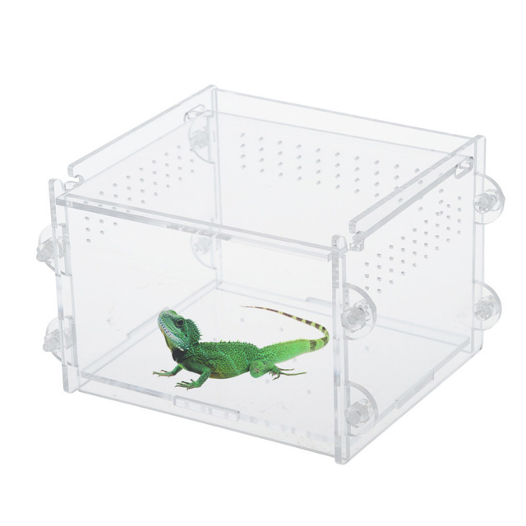
Configuration highlight: CHI-in-a-Box
CHI-in-a-box: packaging of CHameleon Infrastructure (CHI)
Internal packaging of a commodity-based testbed
Packages the system as well as the operations model
Hub and spoke management, version-controlled site configuration management as code, containerization, monitoring, detection, and remediation tools
Support for Bring Your Own Device (BYOD) model: Doni allows administrators to dynamically enroll resources, define availability windows, and streamline operations
Deployment
Deployed Associate/Volunteer Sites: NCAR, Northwestern, NRP, and UIC
Independent testbed: ARA
In conversation/progress: OCT/U Mass, FIU, ORNL, KTH (edge/wireless only), NUS, and others
Paper: “CHI-in-a-Box: Reducing Operational Costs of Research Testbeds ”, PEARC’22

Slide 14
Hardware/configuration: CHI@Edge
A lot like a cloud!
All the features we know and love – but for edge!
“Edge to cloud from one Jupyter notebook.”
Not at all like a cloud!
Location, location, location!
IoT: cameras, actuators, SDRs!
Not server-class!
And many other challenges!
CHI@Edge: all the features you love in CHI, plus:
Reconfiguration through non-prescriptive container deployment via OpenStack interfaces (using K3 under the covers)
Support for “standard” IoT peripherals (camera, GPIO, serial, etc.) + easy for you to add support for your own peripherals
Bring Your Own Device (BYOD): Mixed ownership model via an SDK with devices, virtual site, and restricted sharing – building on OpenBalena
15-20% of new research projects use CHI@Edge
Coming soon: better networking, IoT support, and ease of use
“Chameleon@Edge Community Workshop Report”, 2021
Notes:
Non-prescripttive!
Coming soon: Networking, ease of use for development, and IoT peripherals – from proposal
Earlier this year in production
Now ~15% of new research projects on Chameleon use CHI@Edge
Pi 5 support, peripheral guide, and others

Slide 15
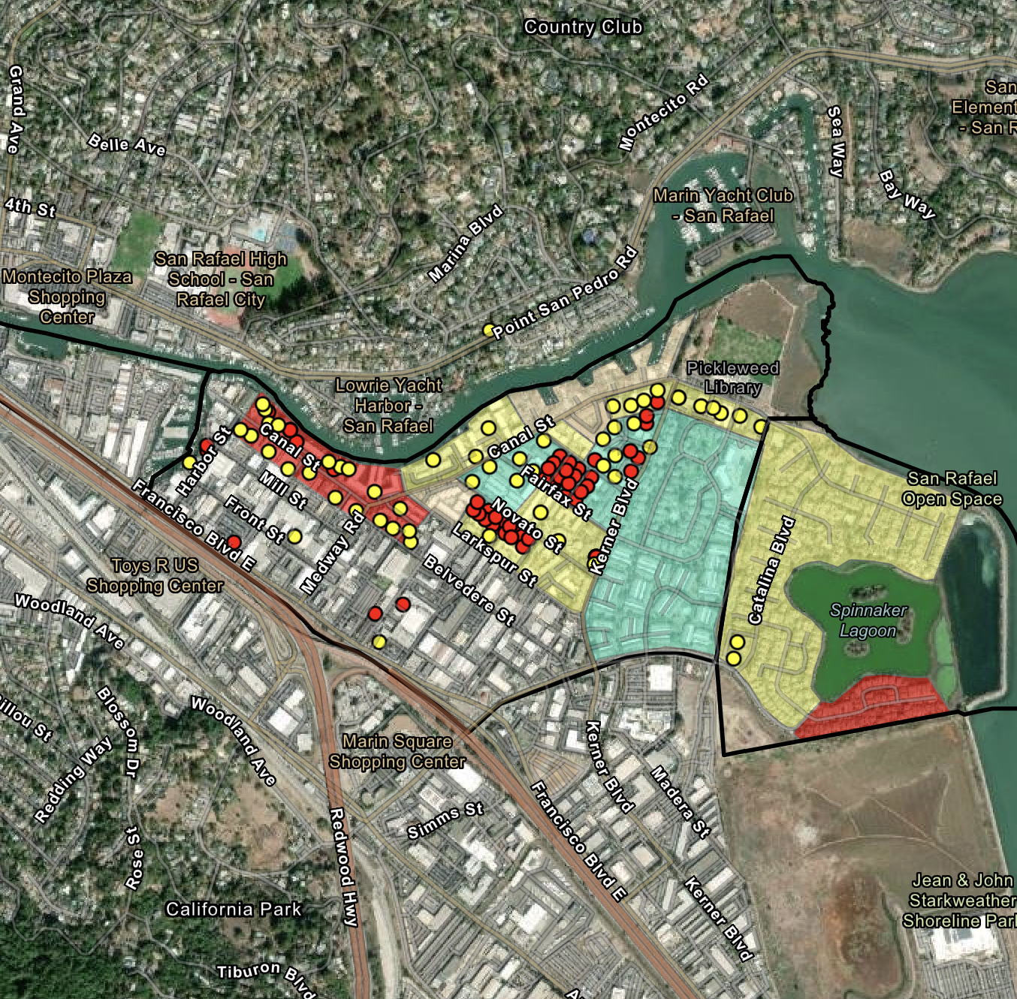
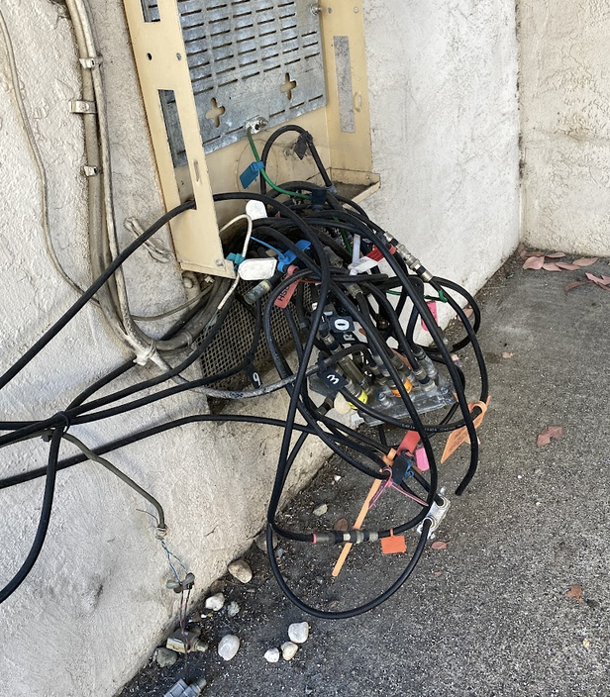
FLOTO: Giving broadband measurement an edge
Scientific instrument for measuring broadband
Deploy 1,000 Pis nationwide (~500 so far)
Chicago, IL; Milwaukee, WI; San Rafael, CA
Marion County, IL; Beaver Island, MI -- and others
Measurement Applications
Netrics; Measurement Lab’s (MLab) Measurement Swiss Army Knife (MSAK) toolkit; RADAR toolkit; NetUnicorn; rural broadband tests (ARA) – and others
Data
13M data points, spanning 17 providers (national and local), across multiple different technologies
Publicly available on FLOTO website
How powerful is this dataset?
Marion County: 32% of sampled households below the federal threshold
Beaver Island: area challenge to FCC -> reassessment of broadband coverage
floto.cs.uchicago.edu
Notes:
across different technologies
fiber, cable, satellite, and fixed wireless.
Some of the FLOTO deployments (San Rafael, Beaver Island, and Marion County) have also been used in assessment activities related to the
federal Broadband, Equity, Access, and Deployment (BEAD) program that seeks to expand broadband connectivity and promote digital inclusion nationwide [22]. For instance, in Marion County, IL, we deployed 19 devices over a 3-week period, collecting about 586,636 measurements per device. This study revealed that 32% of sampled households were below the 25/3 Mbps federal threshold, directly informing a grant application for new fiber infrastructure. Similar results were obtained through the deployment in Beaver Island, MI where study results were used to generate an area challenge to the FCC leading to reassessment for broadband coverage.

Slide 16
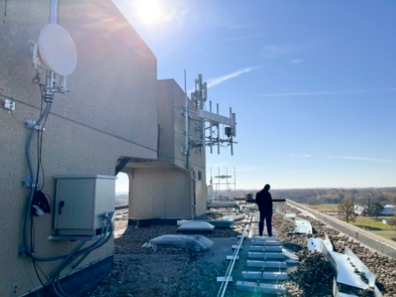
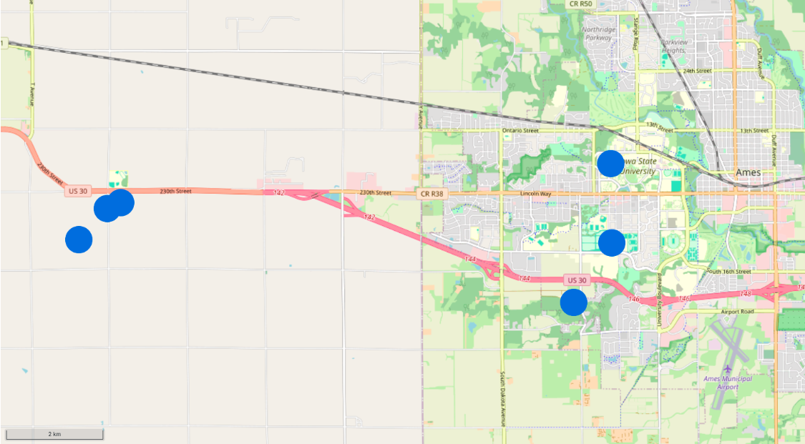
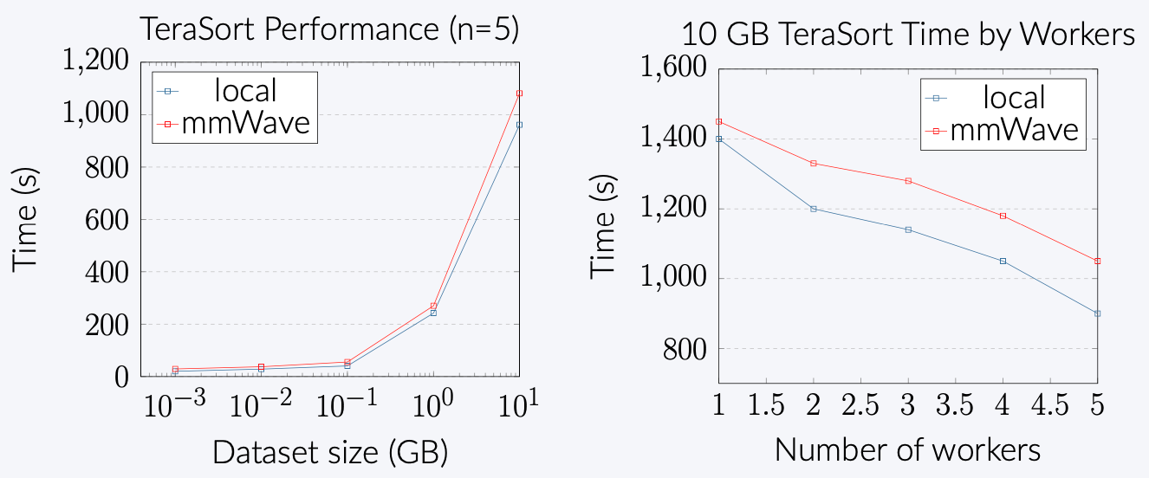
Measuring rural Wireless
Collaboration with ARA project
Assessing the quality of rural 5G networks
Measuring device to device latency
Clock synchronization
Comparing over different network fabrics
Deployed 6 Raspberry Pi devices with 5G connectivity in rural Iowa
Latency measurements: GPS-based time synchronization for precise measurements (4000x more precise than NTP over 5G)
Tested using Hadoop
Hey presto: 5G networks can support distributed computing with performance comparable to wired connections!
Zack Murry, University of Missouri

Slide 17
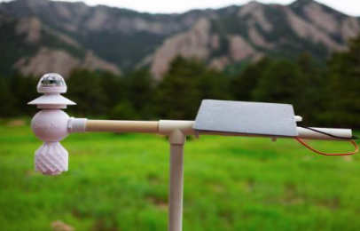
NCAR Weather sensing stations
openIoTwx: NCAR 3D printed weather stations
Richer continuum: IBIS SBCs connecting to openIoTws via LoRa
Exploring power (4x factor), connectivity (cellular vs aggregation via LoRa), sensing (additional camera sensors), and processing (to e.g., reduce size of data) trade-offs
Future challenges
Image-based weather prediction methods, scaling up to create dense, high-resolution weather monitoring networks, and assessing long-term reliability in diverse outdoor environments
William Fowler, Tufts University
Notes:
LOng-RAnge (LoRa) radio frequency

Slide 18
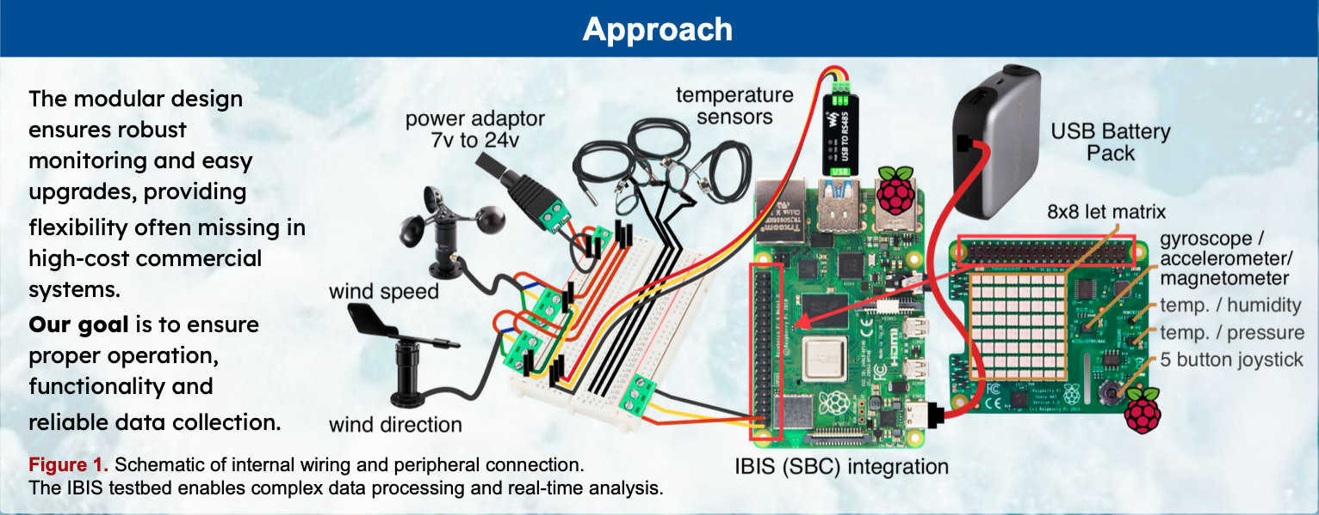
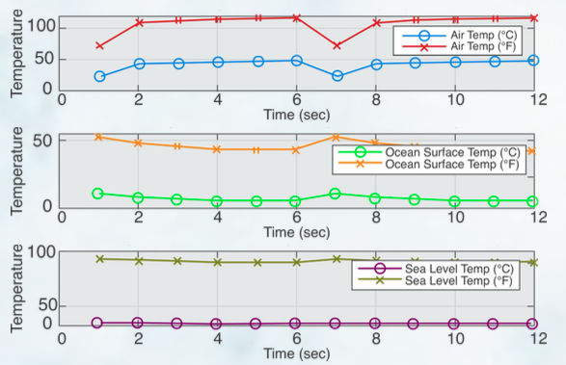
Sensor stations for marine and coastal ecosystems
Smart buoy system: sensor stations for oceanic data collection (water quality, water movement, water levels, etc.)
Collaboration with FIU
Integrated multiple environmental sensors with IBIS infrastructure
Demo deployment with real and simulated data
Implemented cloud-based data visualization system
Collaboration with FIU
Julia Harper, Loyola University

Slide 19
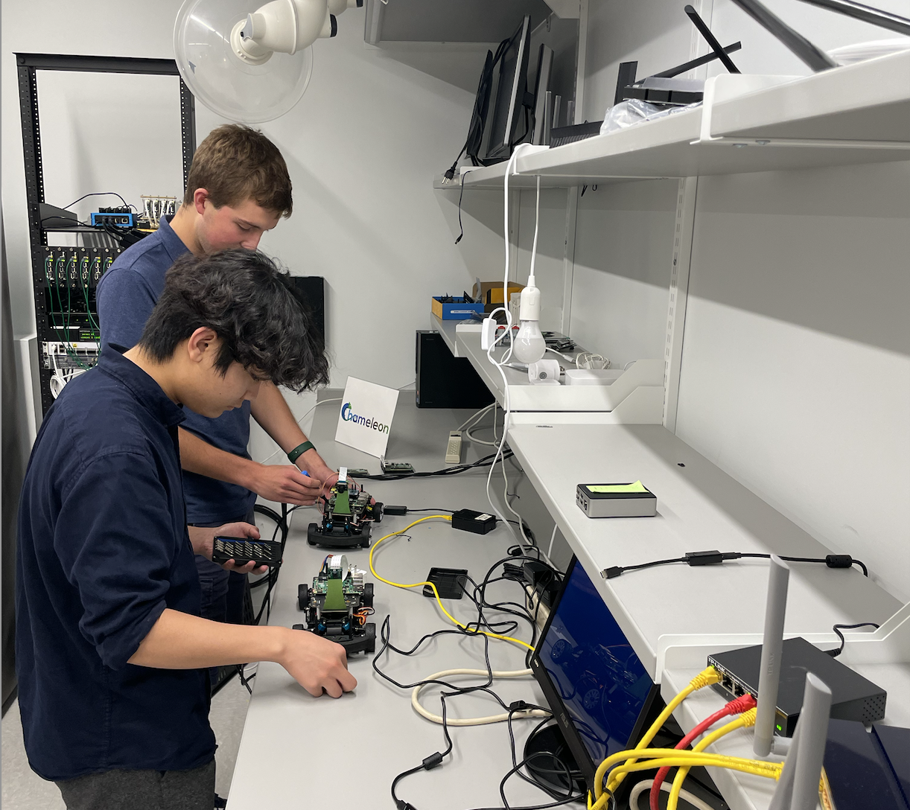
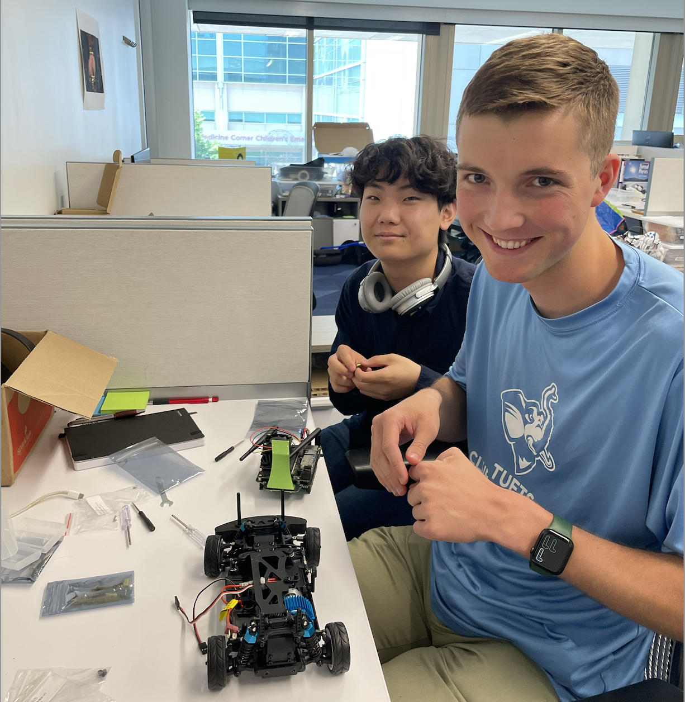
Auto learn
Can I experiment with self-driving cheaply? Can I teach edge to cloud AI concepts in a class in an engaging manner?
AutoLearn Trovi artifact
Data collection (actual car versus simulator)
A library of ML modules
Verification via self-driving (actual car versus simulator)
Different emphasis
Introduction to engineering
Machine learning with just the simulator
Lots of scope for individual exploration
REU 2023 students working on hardware
setup for autonomous vehicles
Paper: “AutoLearn: Learning in the Edge to Cloud Continuum”, EduHPC’23

Slide 20
And others…
Predicting air quality with federated learning
Soundscaping and forestry data analysis
Precision agriculture: optimizing greenhouse environments
Meteorologic monitoring system for ML-based weather forecasts
And others…

Slide 21
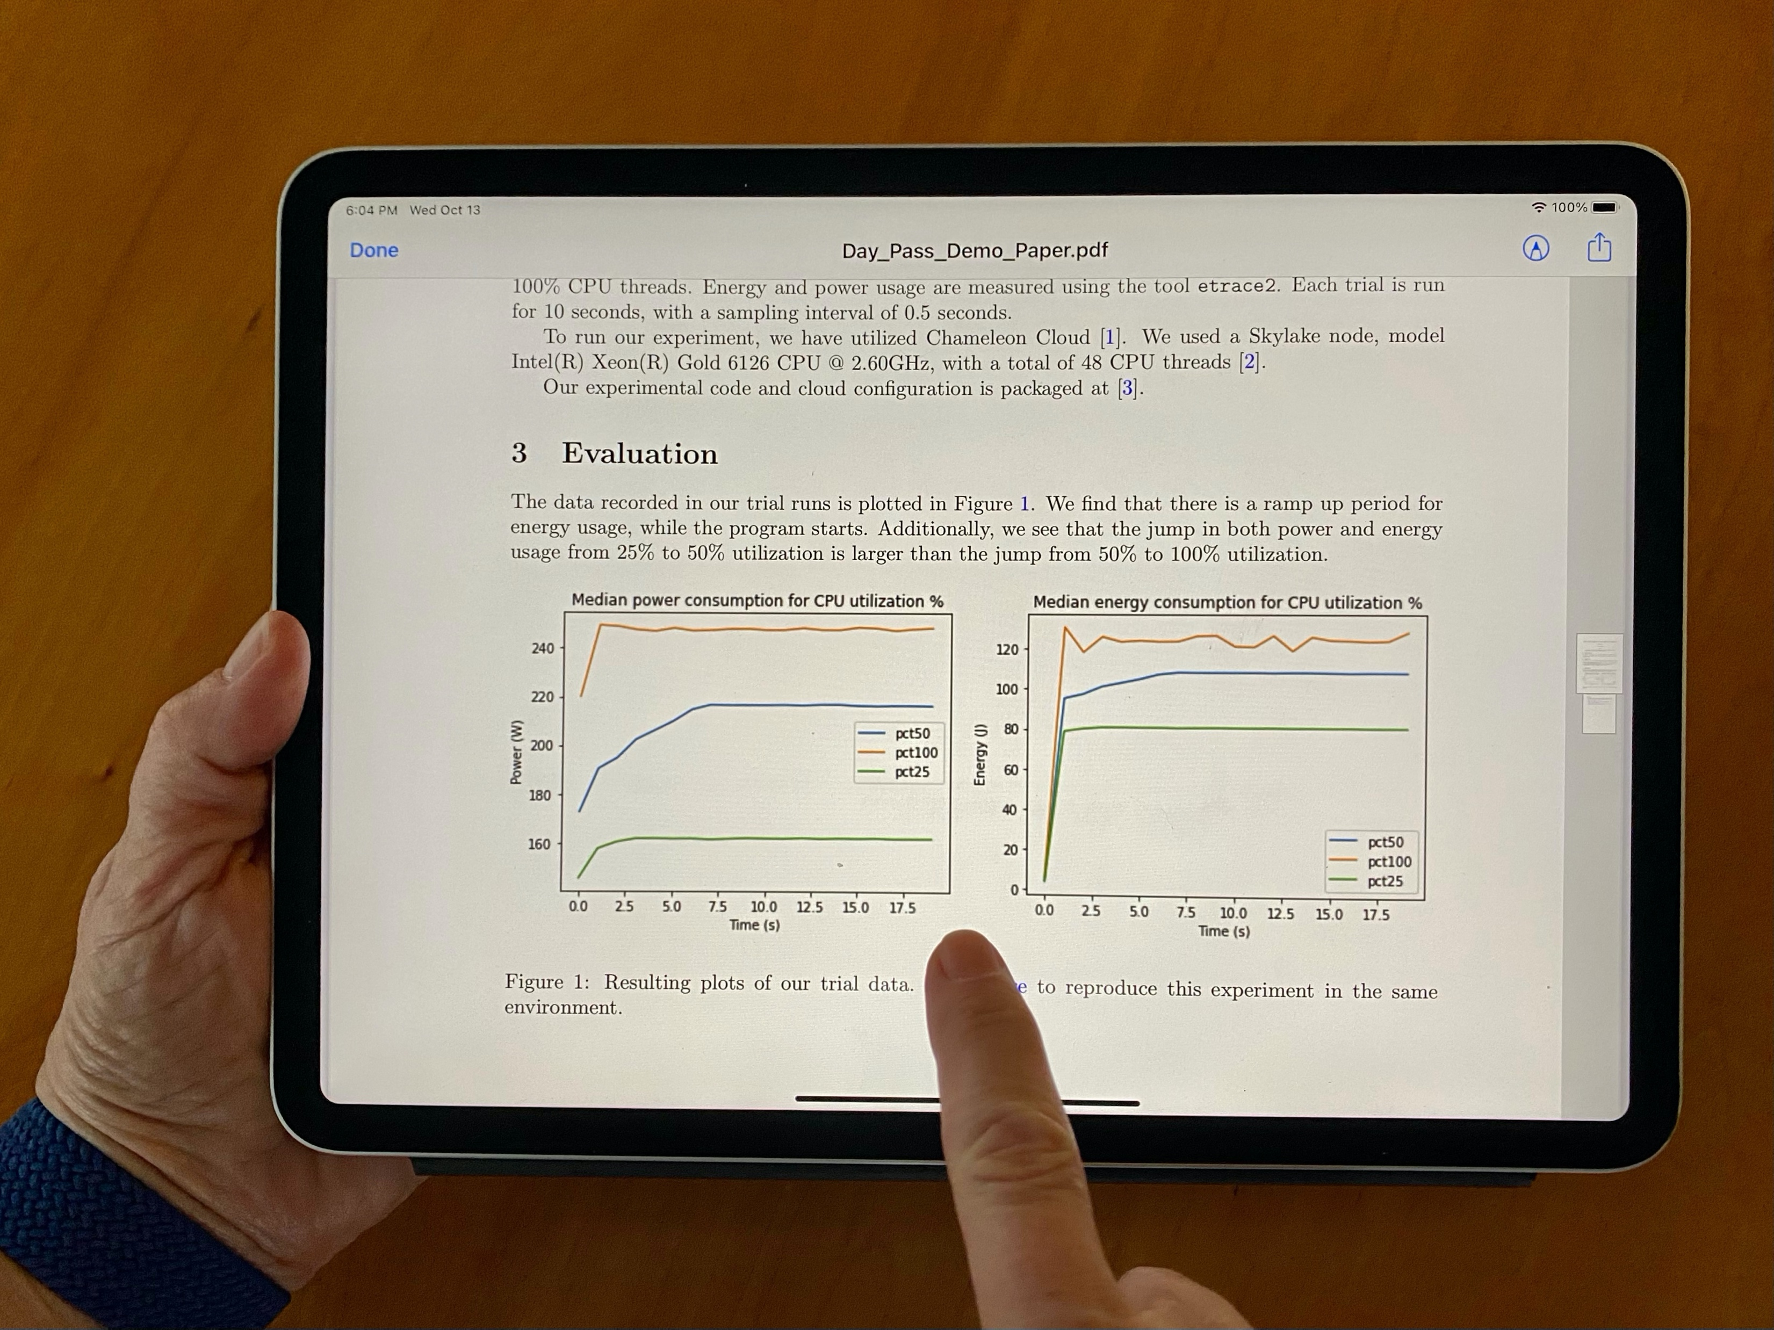
Practical reproducibility
Practical reproducibility == feasible enough to be a mainstream method of scientific exploration
Can digital experiments be as sharable as papers are today?
Is there a library I can go to and find experiments to play with?
Can I simply integrate somebody’s model into my research instead of reinventing the wheel and get to a new result faster?
Can I discover something new through playing with somebody else’s experiment?
Can I develop exercises for my class based on most recent research results?
https://repeto.cs.uchicago.edu

Slide 22
Why are we talking about reproducibility?
Open platforms are essential for sharing – especially in computer science
Open, version-controlled hardware
Non-fungible resources
Experimental environment setup
Disk images, orchestration templates, and other artifacts
Thousands of images, orchestration templates, digital artifacts of various kinds
Are we there yet?
A car without a road
Paper: “The Silver Lining”, IEEE Internet Computing 2020

Slide 23
What is missing?
Packaging: complete, imperative, non-transactional, integrated (literate programming)
Get access for reproducibility
Discover/find experiments through various channels
Package experiment in a way that is cost-effective but also user-friendly
Give access for reproducibility
Share work in progress, completed work, get credit

Slide 24
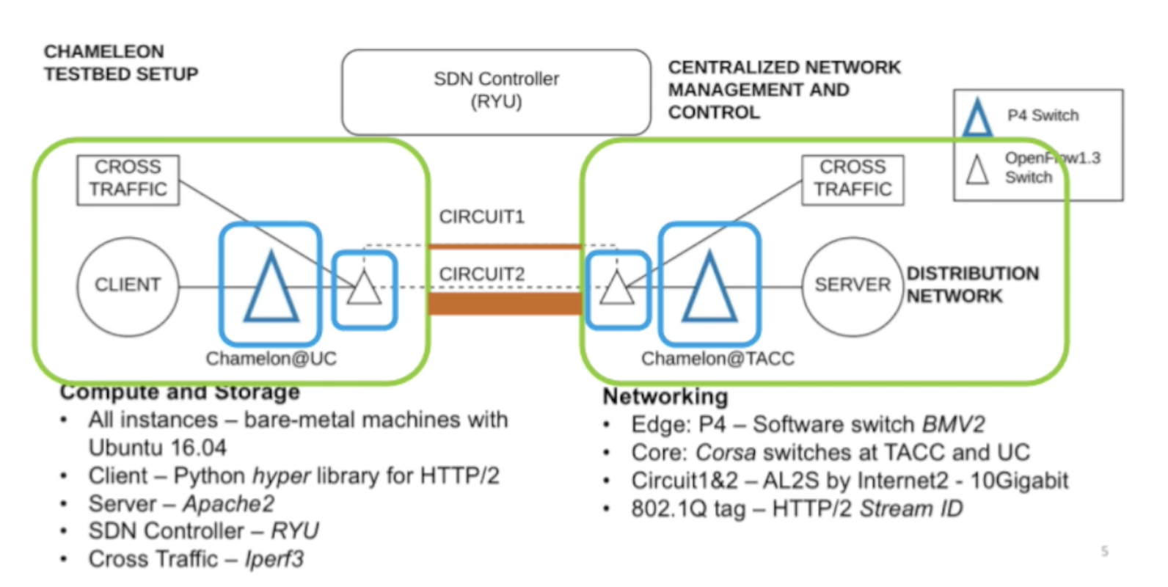
Packaging Experimental environments
Declarative methods
Heat, Terraform, and other mainstream orchestration tools
Hard to introspect and could be tricky for reproducibility
Imperative methods
CLI, python-chi and/or scripts
Potentially via Jupyter integration
Can be re-played incrementally, troubleshooting and making changes as you go
The user chooses the method
Package this!
Complex Experimental containers
via programmable interfaces
Paper: “A Case for Integrating Experimental Containers with Notebooks”, CloudCom 2019

Slide 25
Trovi: Sharing, finding, and replaying experiments
A testbed-integrated open experiment sharing repository integrated with multiple testbeds
Trovi artifacts
Collection of information about all the experiment
Assumes that artifact will be implemented in a variety of ways
Connected to the testbed such that the experimental environment is easy to deploy
Artifacts support fine-grained sharing, versioning, and provide metrics about usage
Portal to present, browse, filter, and find interesting experiments
Open APIs: can be integrated with any testbed
Paper: “Three Pillars of Reproducibility”, ReWords’23

Slide 26
Trovi: Authors and reproducers
Authors
Start with an experiment on GitHub
The experimental environment can be implemented either via forking an existing Chameleon experiment or implementing a new one yourself
To add to Trovi generate a meta-data file that contains experiment description and provides a ”hook” to your environment creation files
Reproducers
Reproducers can identify experiments based on experiment subject matter, experimental methodology, or other factors
Click on the artifact to find out more information
Click on “launch on Chameleon” to create an experimental environment and run your experiment

Slide 27
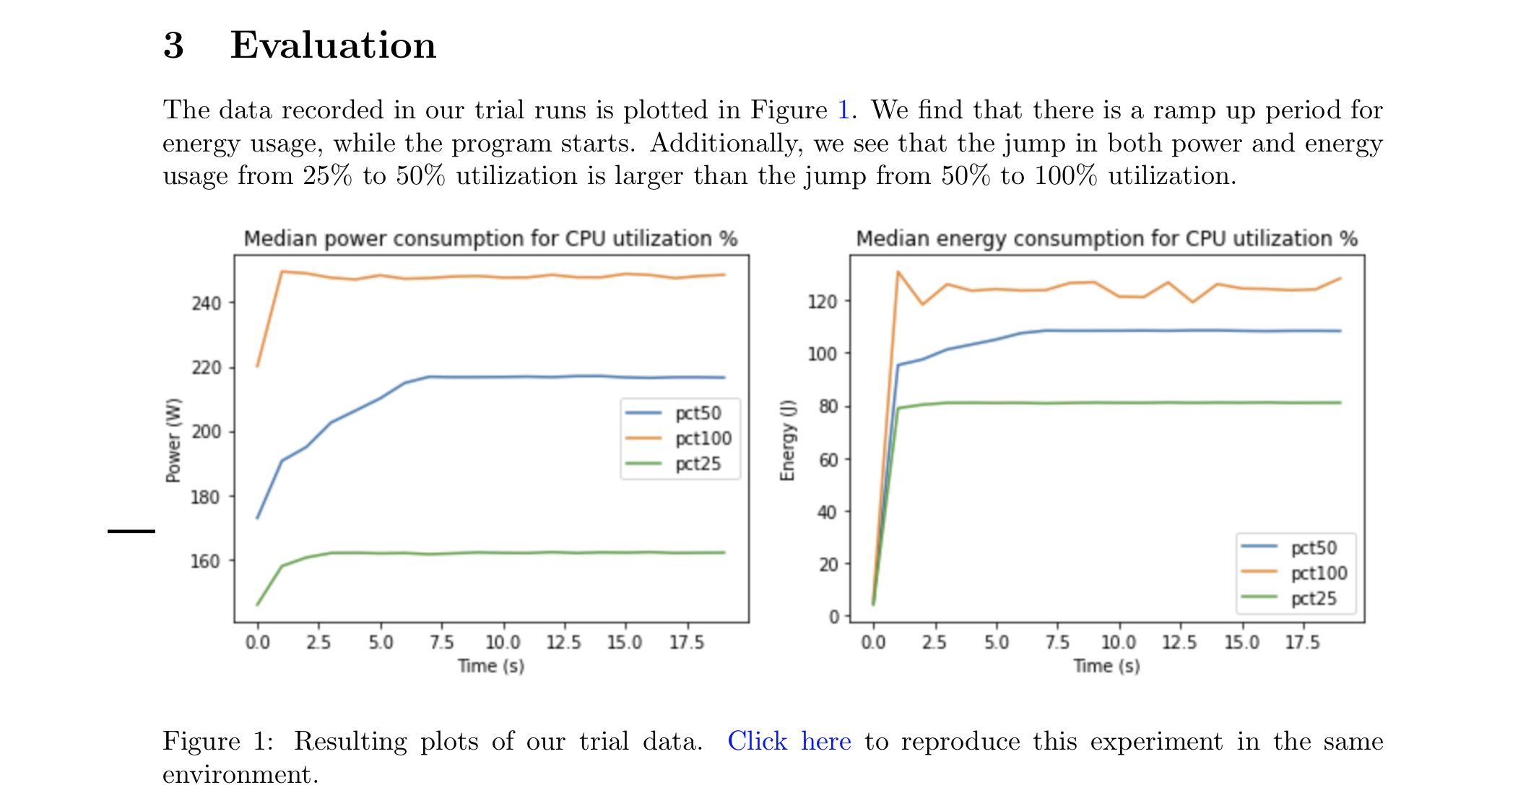
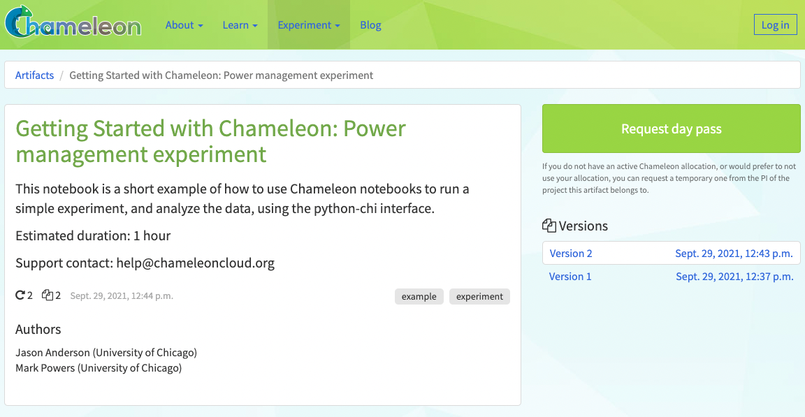
Testbed access with chameleon daypass
Authors create a subproject with multiple short-term leases that are long enough to reproduce the experiment
Readers click through data of a published experiment, request a daypass, and reproduce either the experiment or data analysis

Slide 28
Parting thoughts
Chameleon has been in existence for 10 years
Much experience on how to provide a platform for experimental research
…and how to adapt
It takes a village: partnerships with FABRIC, NRP, and PAWR projects allow us to add different experimental dimensions to the platform
A road for the car: we need open infrastructure, designed with CS needs in mind, to make reproducibility viable
Capture the moment: working with the community on making great research reproducible!

Slide 29
We’re here to change
www.chameleoncloud.org

